Slide 1

A Personal Learning Framework
Stephen Downes
World Conference in Online Learning, Toronto, Canada, October 18, 2017
http://www.downes.ca/presentation/479

Slide 2
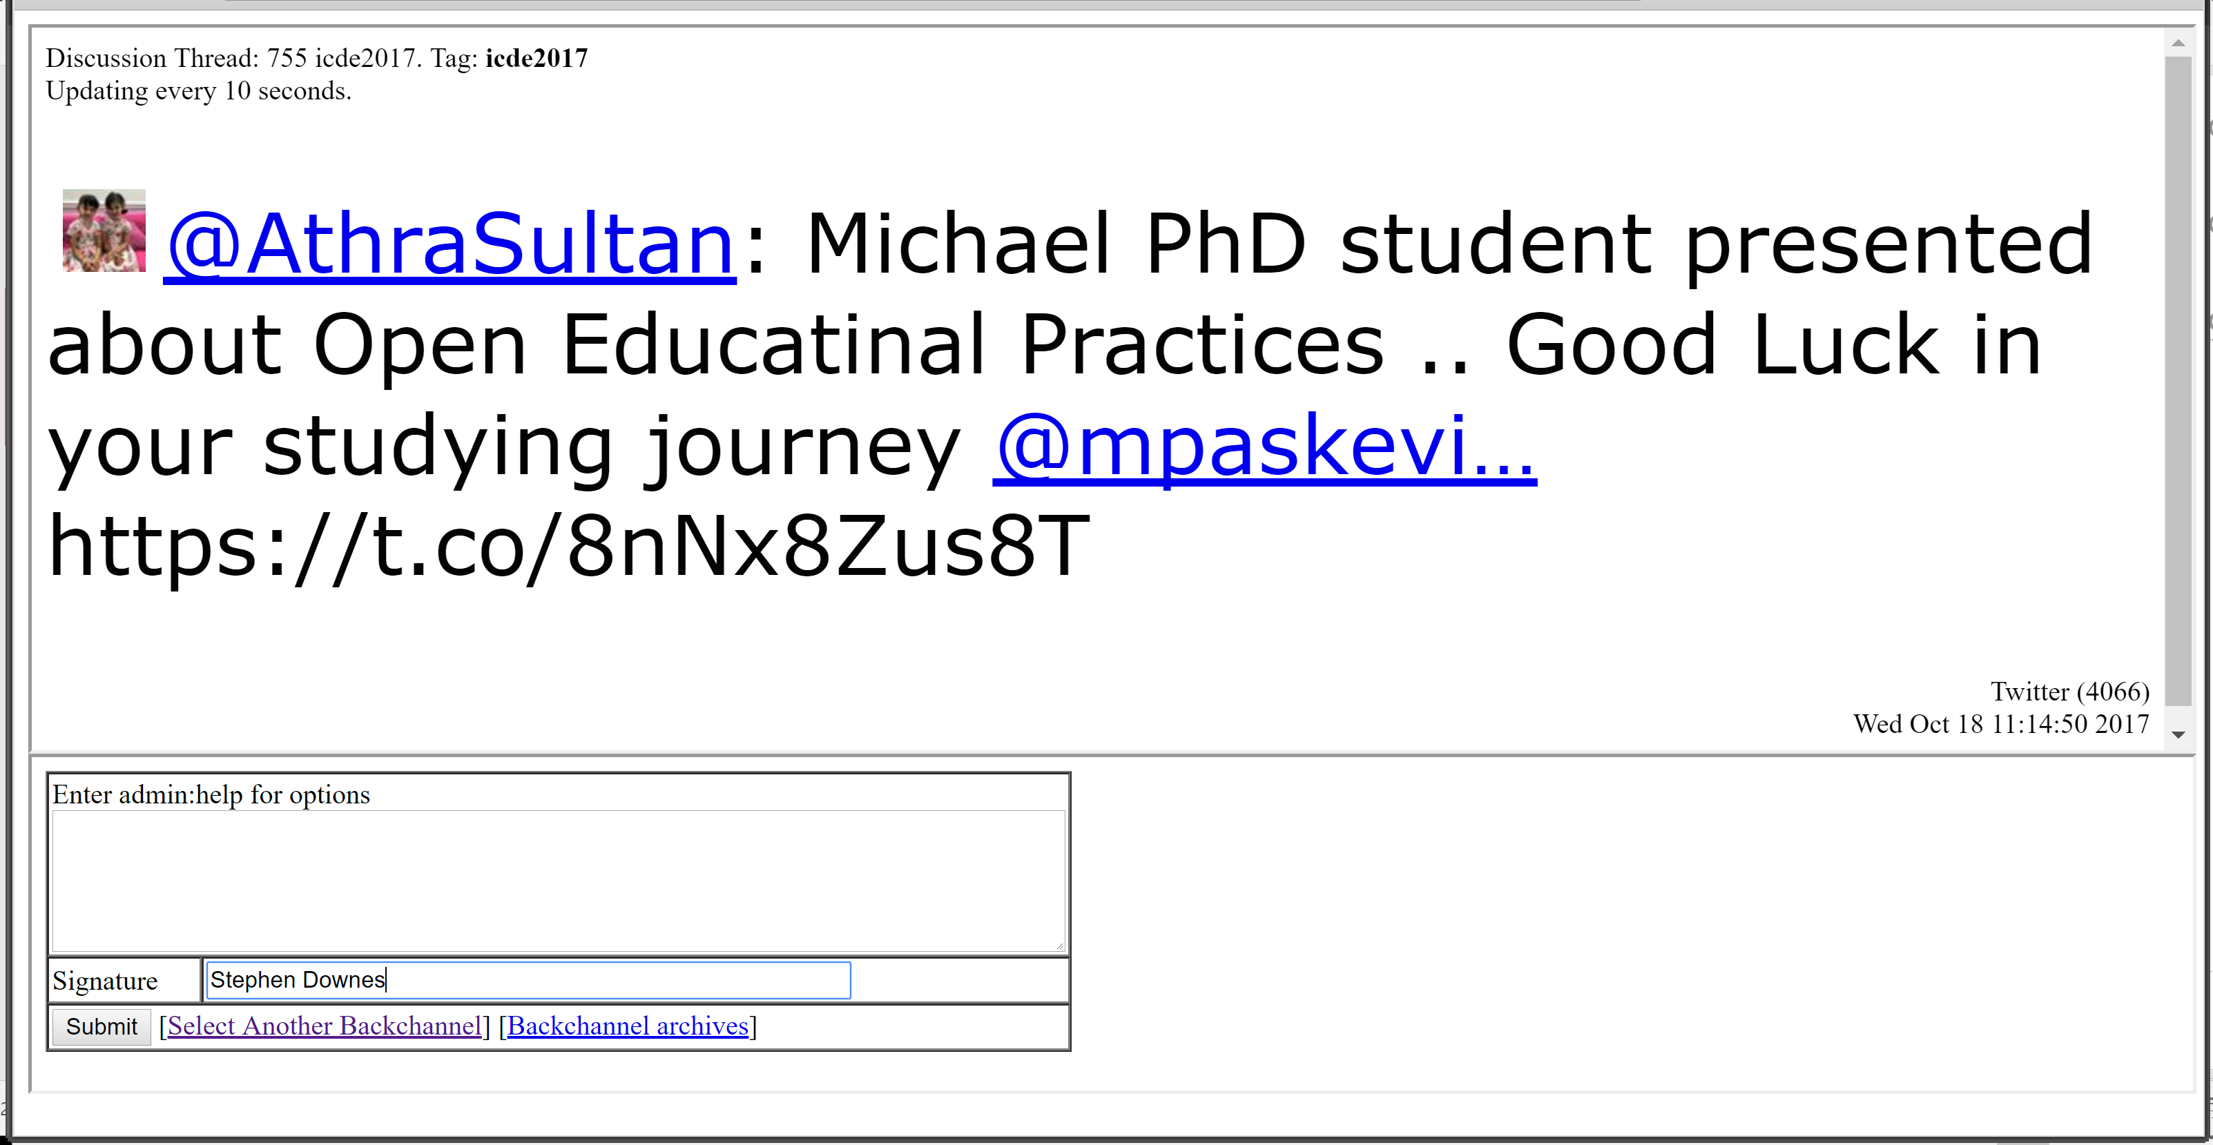
The Backchannel
Use Twitter with the hashtag #icde2017
Or go to
http://bit.ly/icde2017 and use the live comments form
If it looks broken, just reload it. ☺

Slide 3
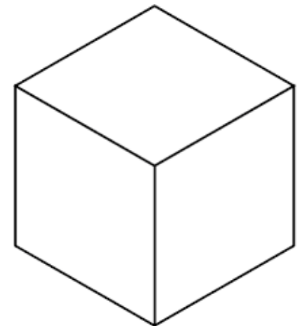
Knowledge

Slide 4
Fact

Slide 5
Skill

Slide 6
Competency

Slide 7
Content

Slide 8
Behaviourist
Disposition
Rule
Constructivist
Meaning
Model, Representation
Cognitivist
Reference
Truth
Connectivist
Recognition
Structure, Learning Theory

Slide 9
Intuitionalist
Behaviourist
Disposition
Rule
Constructivist
Meaning
Model, Representation
Operationalist
Cognitivist
Reference
Truth
Connectivist
Recognition
Structure, Learning Theory
Functionalist

Slide 10
Intuitionalist
Behaviourist
Disposition
Rule
Constructivist
Meaning
Model, Representation
Operationalist
Cognitivist
Reference
Truth
Connectivist
Recognition
Structure, Learning Theory
Functionalist

Slide 11
Content

Slide 12
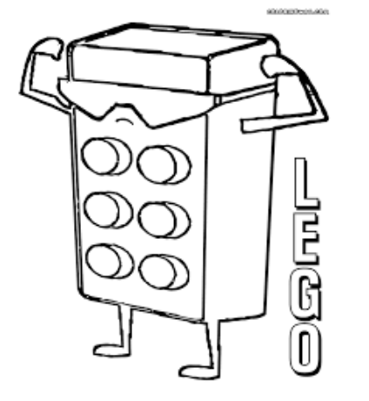
Lego

Slide 13

Cell

Slide 14

Atom

Slide 18
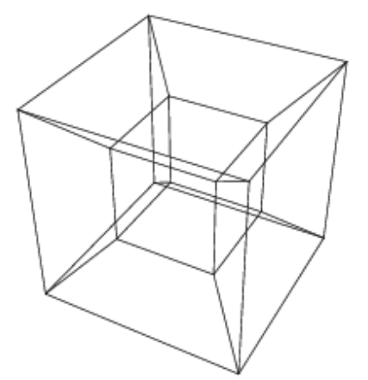

Slide 19
Pedagogy
Architecture
Evidence
Literacies
Values
Skills

Slide 20
Pedagogy
Architecture
Evidence
Literacies
Values
Skills

Slide 21
Pedagogy

Slide 22
Personalization?
What is a personalized 21st century education
- personalized education plan (developed by teacher)
- adaptive learning via assessment
- grouping by proficiency, not age
- teacher = director of learning
- cf Kettering Foundation, Individually Guided Education
Personalizing 21st Century Education: A Framework for Student Success
Dan Domenech, Morton Sherman, John L. Brown
Jossey-Bass, a Wiley Brand. 2016

Slide 23
2. Two Approaches…
Content
Practice
Practice
Content

Slide 24
Two Approaches…
Defines an ideal state
Defines a desired state
Content
Practice
Practice
Content
TEST
TRY
Person tests you
Person helps you

Slide 25
Two Approaches…
Defines an ideal state
Defines a desired state
Content
Practice
Correction
Iteration
GAP
Practice
Content
Opport-unity
TEST
TRY
Person tests you
Person helps you

Slide 26
Library Environment
Defines an ideal state
Defines a desired state
Content
Practice
Affordances
Correction
Requirements
Iteration
GAP
Practice
Content
Opport-unity
TEST
TRY
Person tests you
Person helps you

Slide 27
Personalized Personal
We do for you You do for yourself
Defines an ideal state
Defines a desired state
Library
Content
Practice
Environment
Affordances
Correction
Requirements
Iteration
GAP
Practice
Content
Opport-unity
TEST
TRY
Person tests you
Person helps you

Slide 28
Personal vs. Personalized
Compare between:
  Personalized health care (something the National Health Service or Health Management Organization provides)
  Personal health care (something you do for yourself)
Personal goals versus institutional goals
Practice versus content

Slide 29
Pedagogy
Agency
Objective
Elements
Iterations
Roles
Outcomes
Markers

Slide 30
Architecture

Slide 31
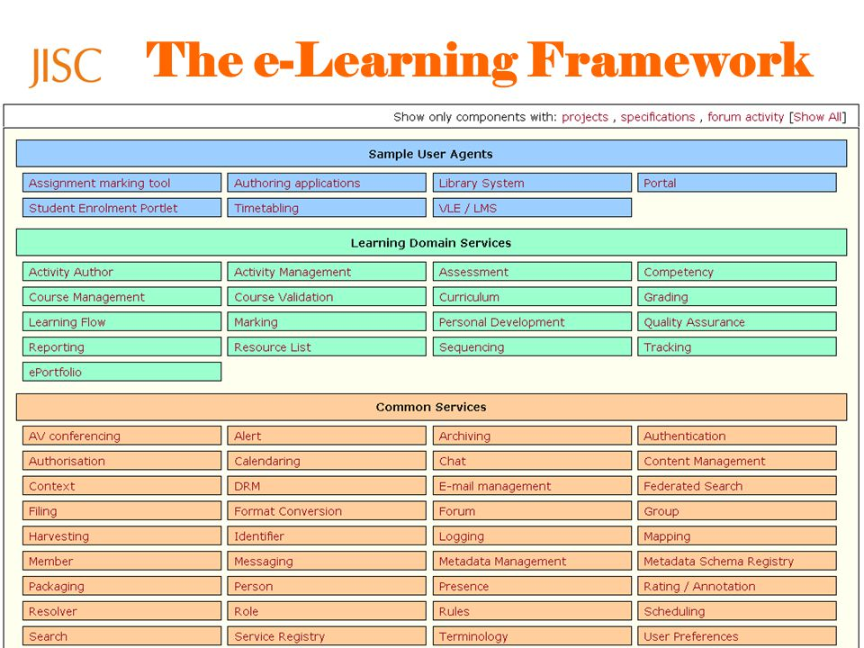
JISC E-Learning Framework
Sarah Porter http://slideplayer.com/slide/4631545/

Slide 32
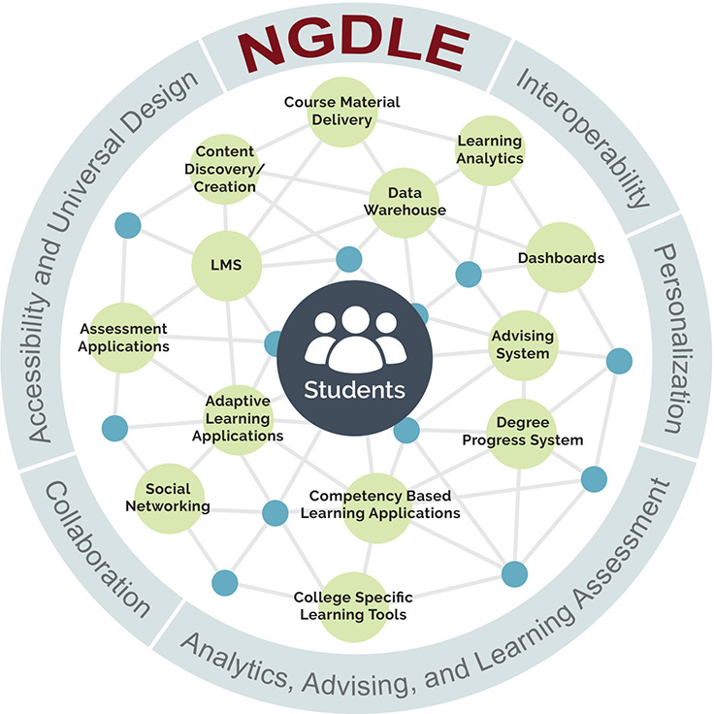
NGDLE
https://er.educause.edu/articles/2017/7/the-ngdle-we-are-the-architects

Slide 33

NGDLE
https://er.educause.edu/articles/2017/7/the-ngdle-we-are-the-architects

Slide 34


NGDLE
https://er.educause.edu/articles/2017/7/the-ngdle-we-are-the-architects

Slide 35



NGDLE
https://er.educause.edu/articles/2017/7/the-ngdle-we-are-the-architects

Slide 36
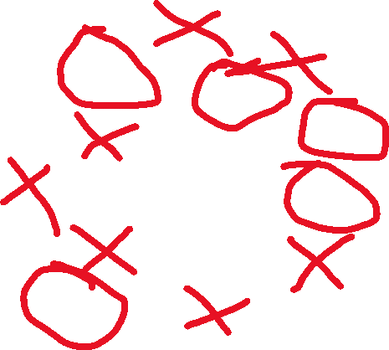
NGDLE
https://er.educause.edu/articles/2017/7/the-ngdle-we-are-the-architects
https://library.educause.edu/~/media/files/library/2015/4/eli3035-pdf.pdf

Slide 37
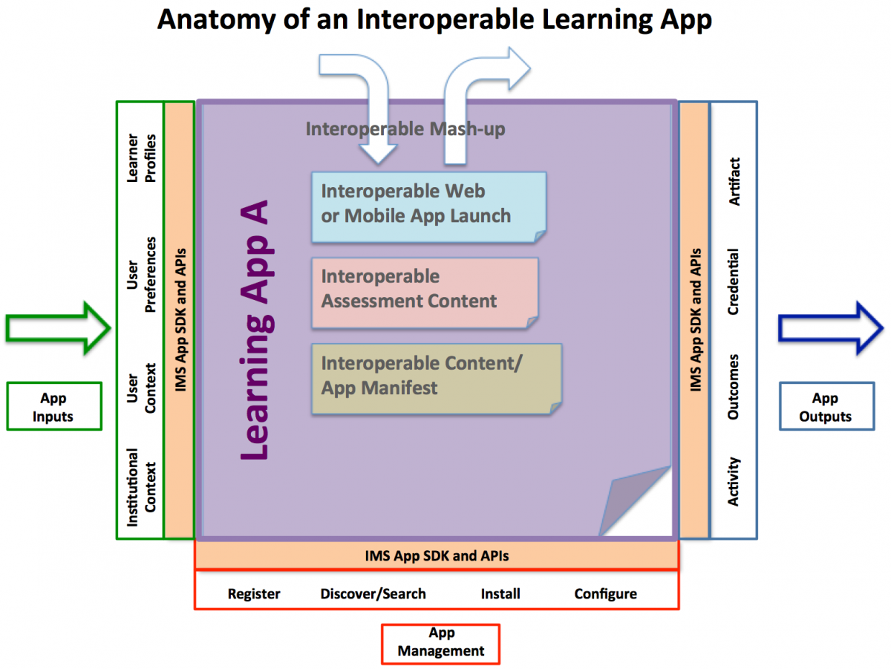
Interoperable Learning App?
https://www.imsglobal.org/article/deeper-dive-next-generation-digital-learning-environment-ngdle-interoperability-part

Slide 38

Interoperable Learning App?
https://www.imsglobal.org/article/deeper-dive-next-generation-digital-learning-environment-ngdle-interoperability-part

Slide 39

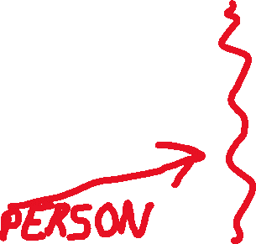
Interoperable Learning App?
https://www.imsglobal.org/article/deeper-dive-next-generation-digital-learning-environment-ngdle-interoperability-part

Slide 40


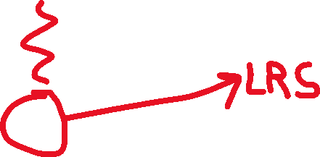
Interoperable Learning App?
https://www.imsglobal.org/article/deeper-dive-next-generation-digital-learning-environment-ngdle-interoperability-part

Slide 41
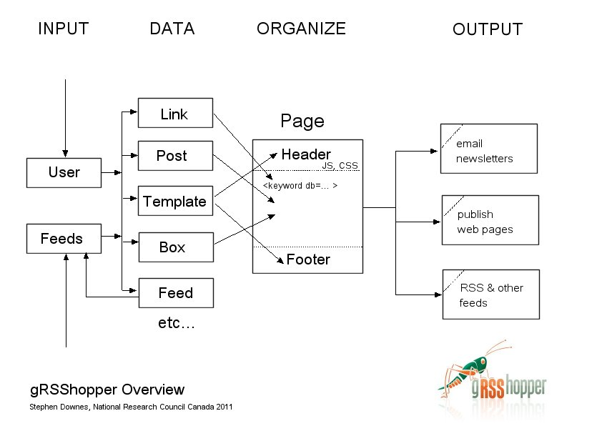
gRSShopper
http://grsshopper.downes.ca

Slide 42
Overview of the Concept of PLEs
LMS
Simulation
PLE
Chat Room
MOOC
Blogger
Intranet
Access to many services in one personal environment

Slide 43
Properties of the PLE…
What information should it record?
Who owns the data? How private is it?
What should it do?
What would a person do with it?
Where, exactly, is a PLE located?
PLE

Slide 44
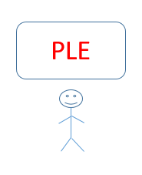
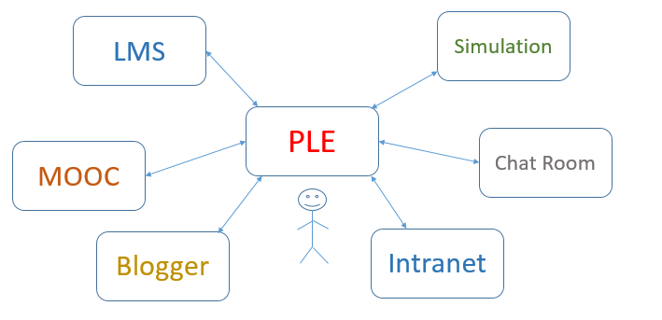
The Network of PLEs

Slide 45
The Social Network of PLEs
twitter
facebook
email

Slide 46
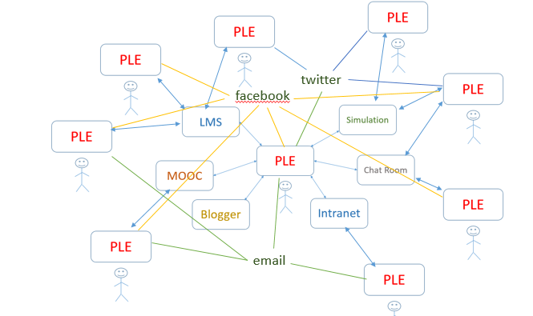
Properties of the Network…
How do people find each other? Services?
How do they communicate? What do they share?
How does a single PLE work with services?
Do we need centralized registries?

Slide 47

Why a personal learning environment?
10:30 – 11:30
What is the value proposition for a PLE?
  Note: value isn’t what you can do, it’s how you benefit
  This is usually stated in financial terms (earn more, cost less)
  Can also be stated in terms of quality: faster, bigger, better
  And can be non-financial goods: satisfaction, happiness, memories

Slide 48
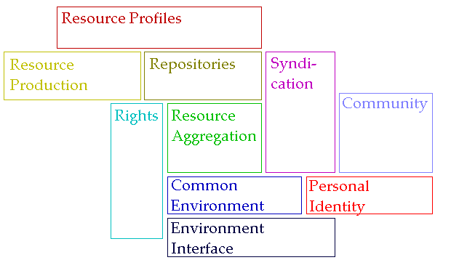
Personal Learning Architecture

Slide 49
Architecture
Resource Production
Repositories
Rights
Identity
Environment
Interface
Community

Slide 50
Architecture
Resource Production
Repositories
Rights
Identity
Environment
Interface
Community

Slide 51
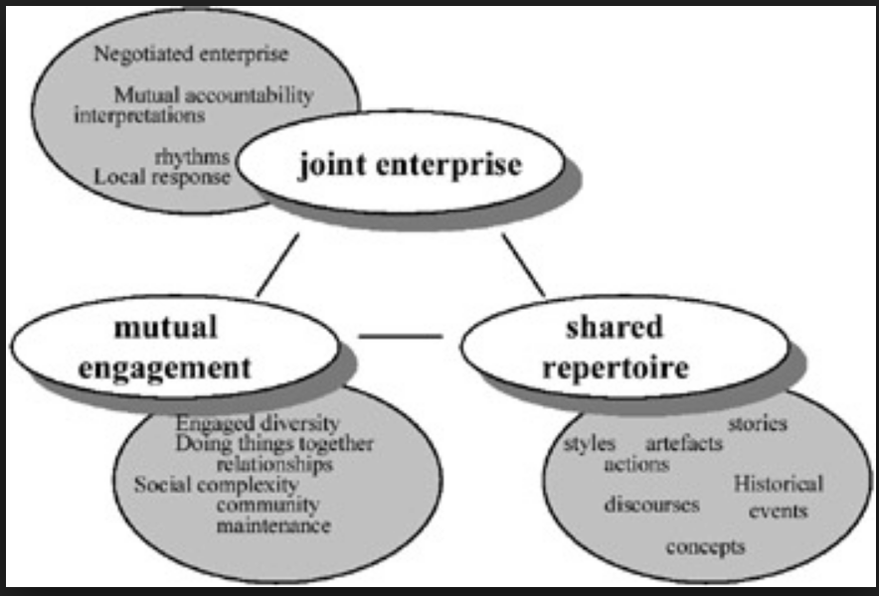
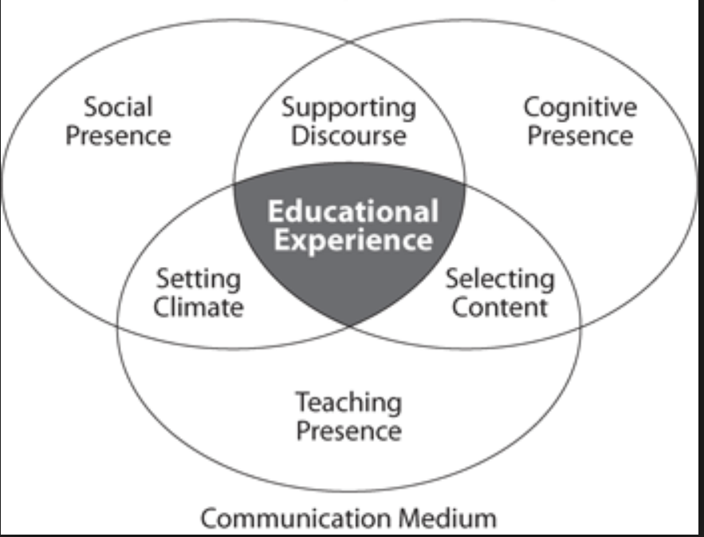
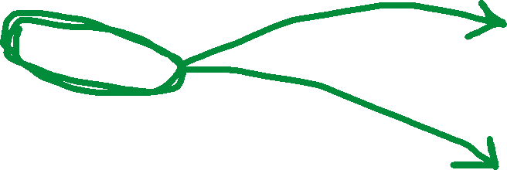
Architecture
Resource Production
Community of Practice
Repositories
Rights
Identity
Environment
Interface
Community
Community of Inquiry

Slide 52
Values

Slide 53
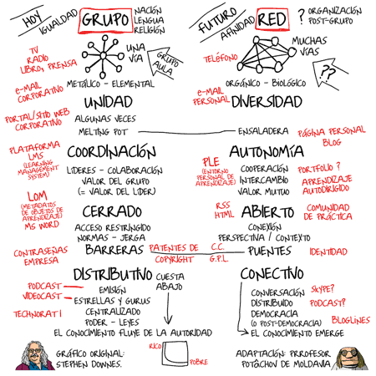
Groups Versus Networks

Slide 54
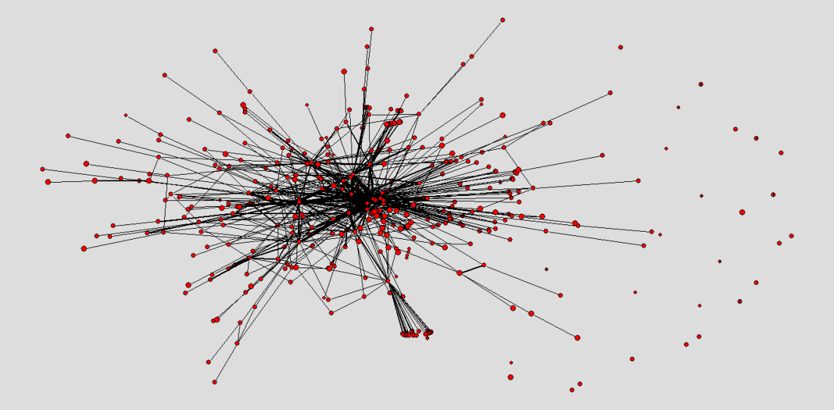
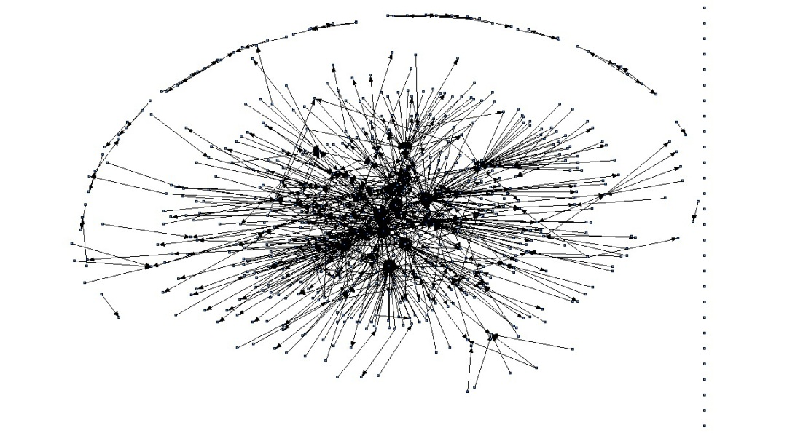
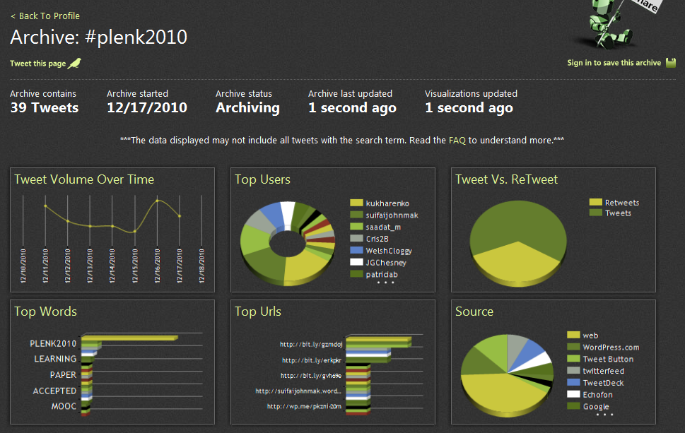
The Semantic Condition
Autonomy, diversity, openness, interactivity
These conditions are the conditions for a constructive dialogue…
And are thus the design principles for a MOOC
http://itforum.coe.uga.edu/paper92/paper92.html

Slide 55

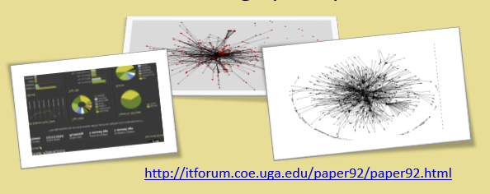
Values
Autonomy
- Choice of contents
- Personal learning
- No curriculum
Openness
- Open access
- Open content
- Open activities
- Open assessment
Diversity
- Multiple tools
- Individual perspective
- Varied content
Interactivity
- Encourage communication
- Cooperative learning
- Emergent knowledge

Slide 56
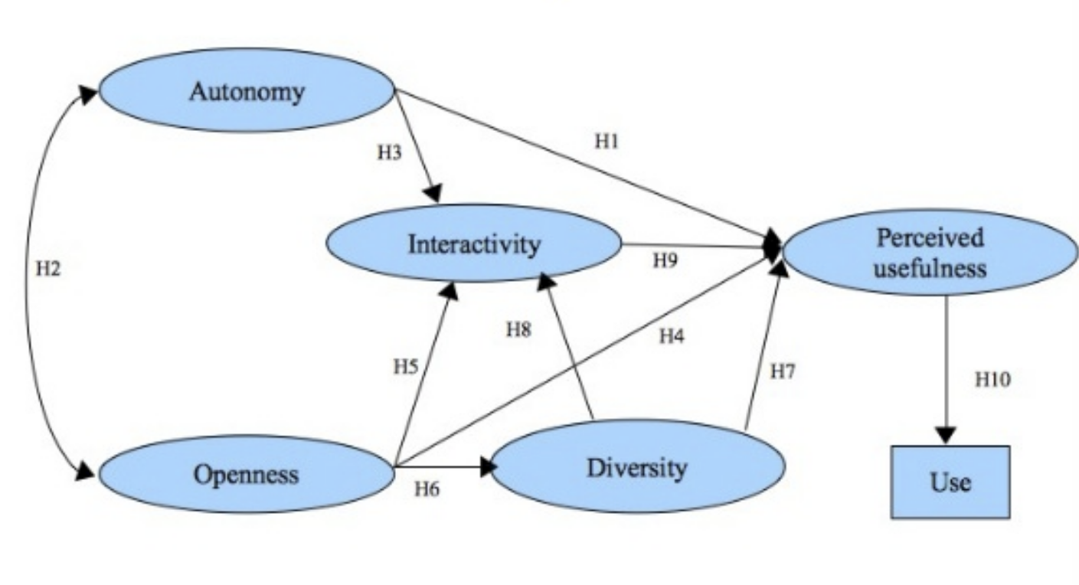
Skills
Oriol Miralbell
https://www.slideshare.net/jomiralb/social-networking-sites-and-knowledge-exchange-the-proposal-of-an-acceptance-model

Slide 57
Autonomy
Values
Diversity
Openness
Interactivity

Slide 58
Skills

Slide 59
The ARRFF Model
Aggregate
Remix
Repurpose
Feed Forward

Slide 60
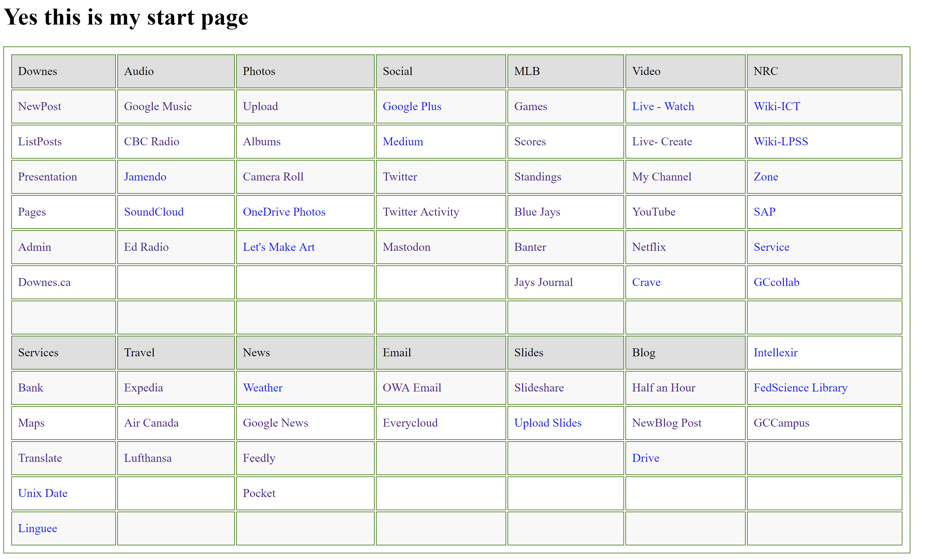
Aggregate

Slide 61
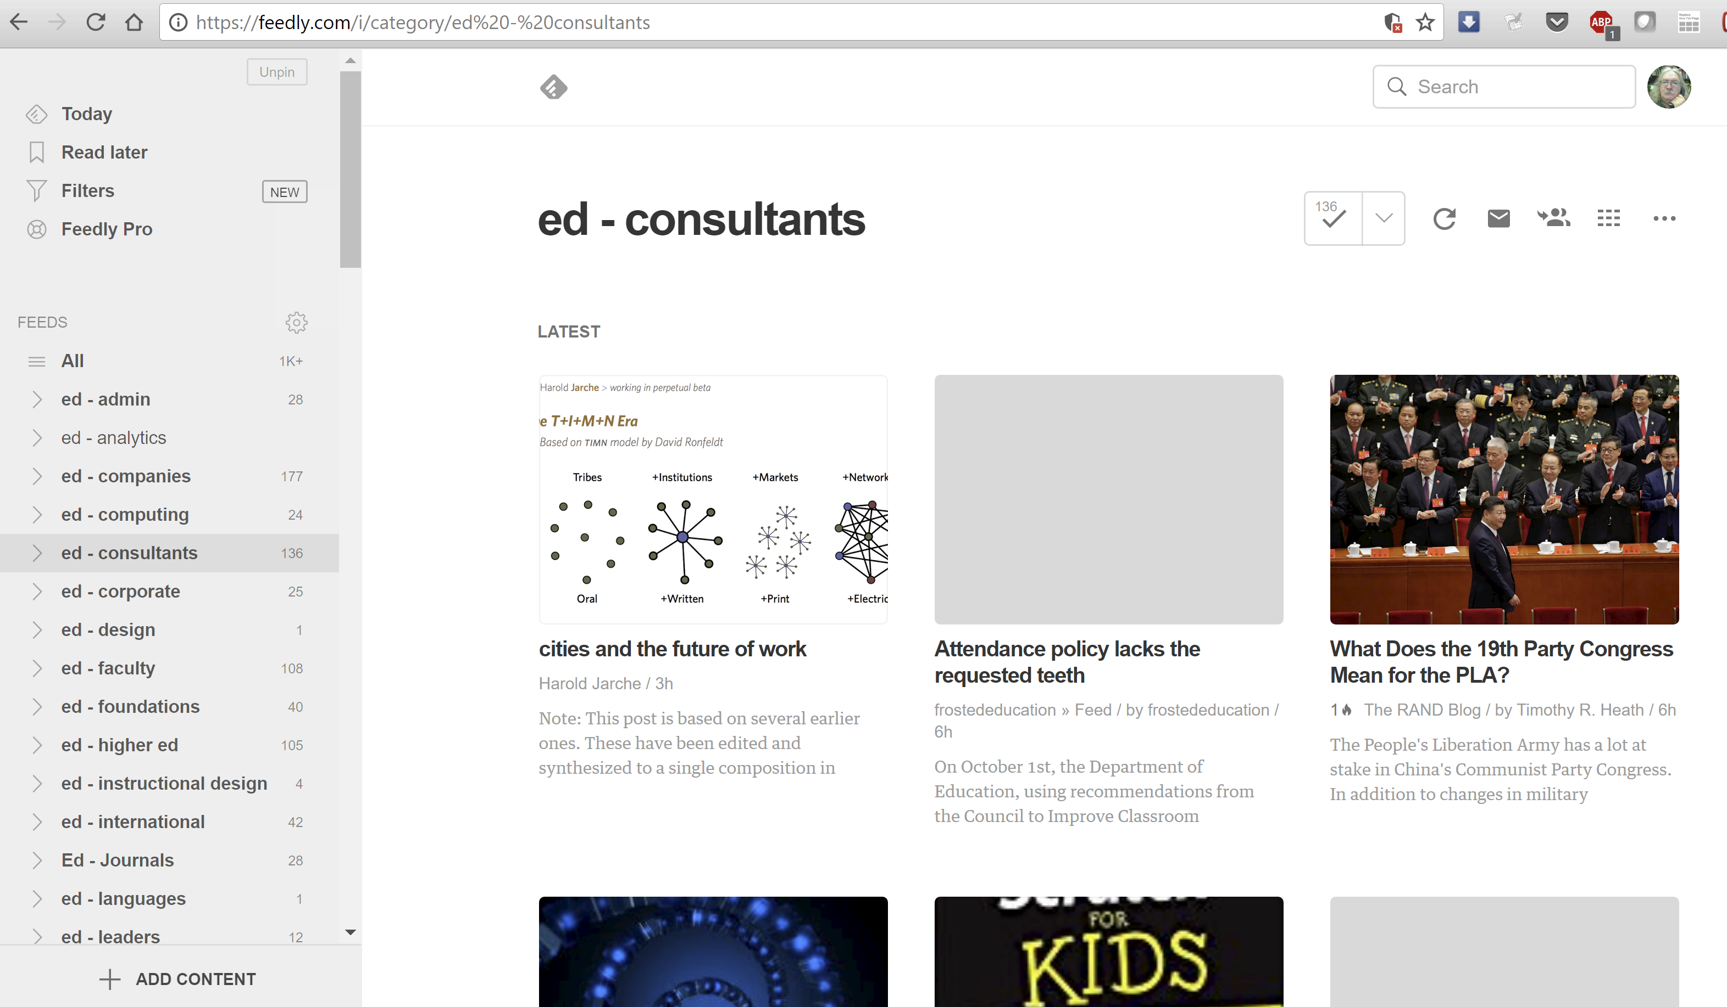
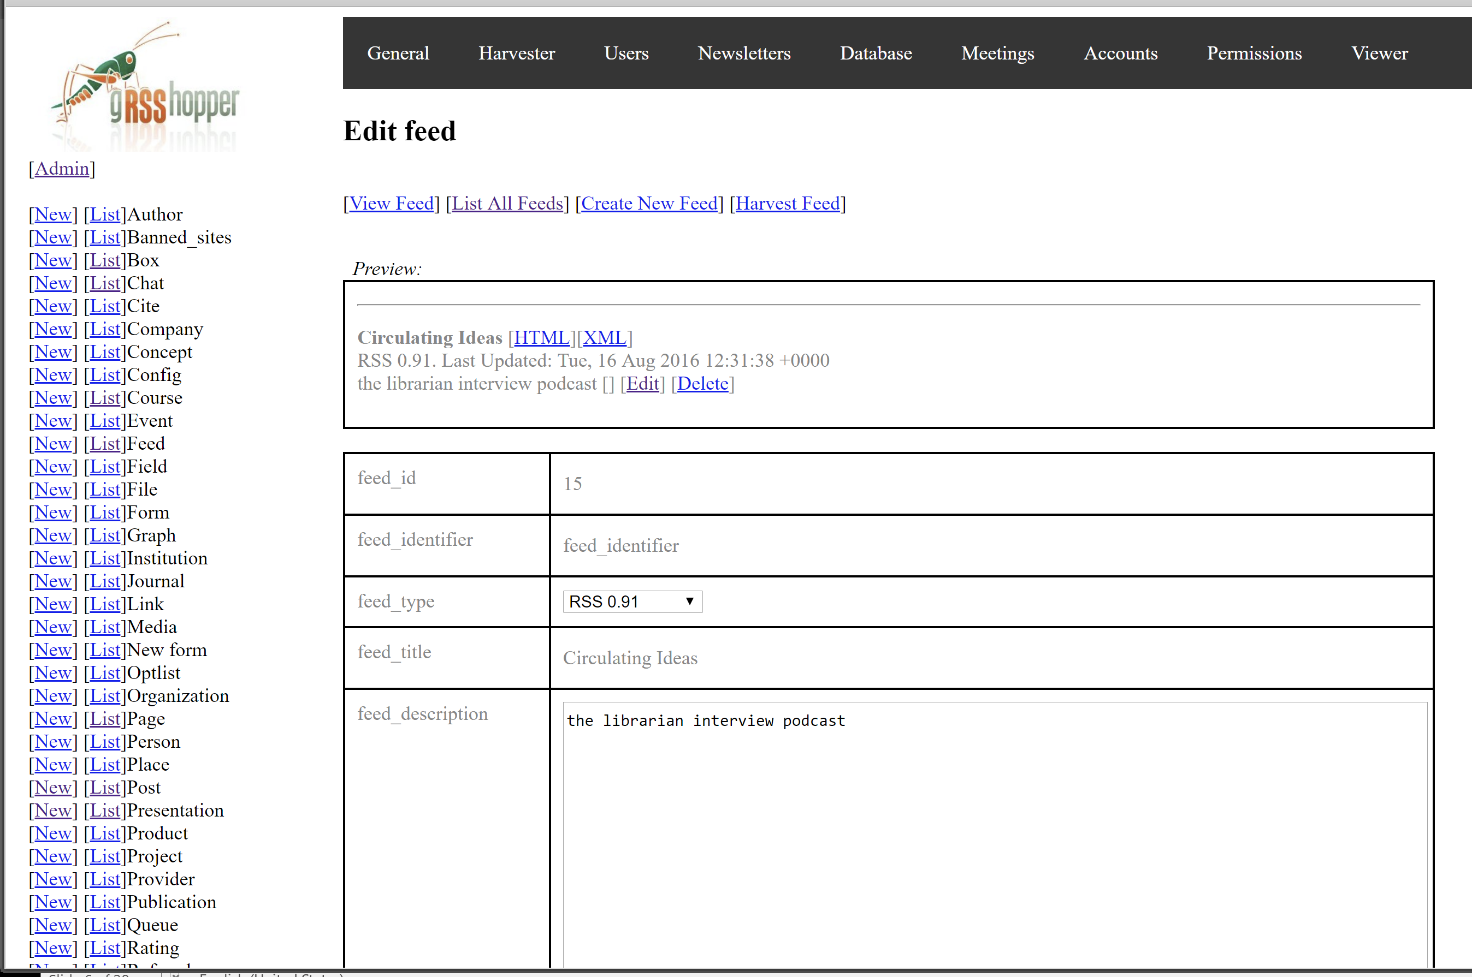
Aggregate
https://feedly.com
http://grsshopper.downes.ca/

Slide 62
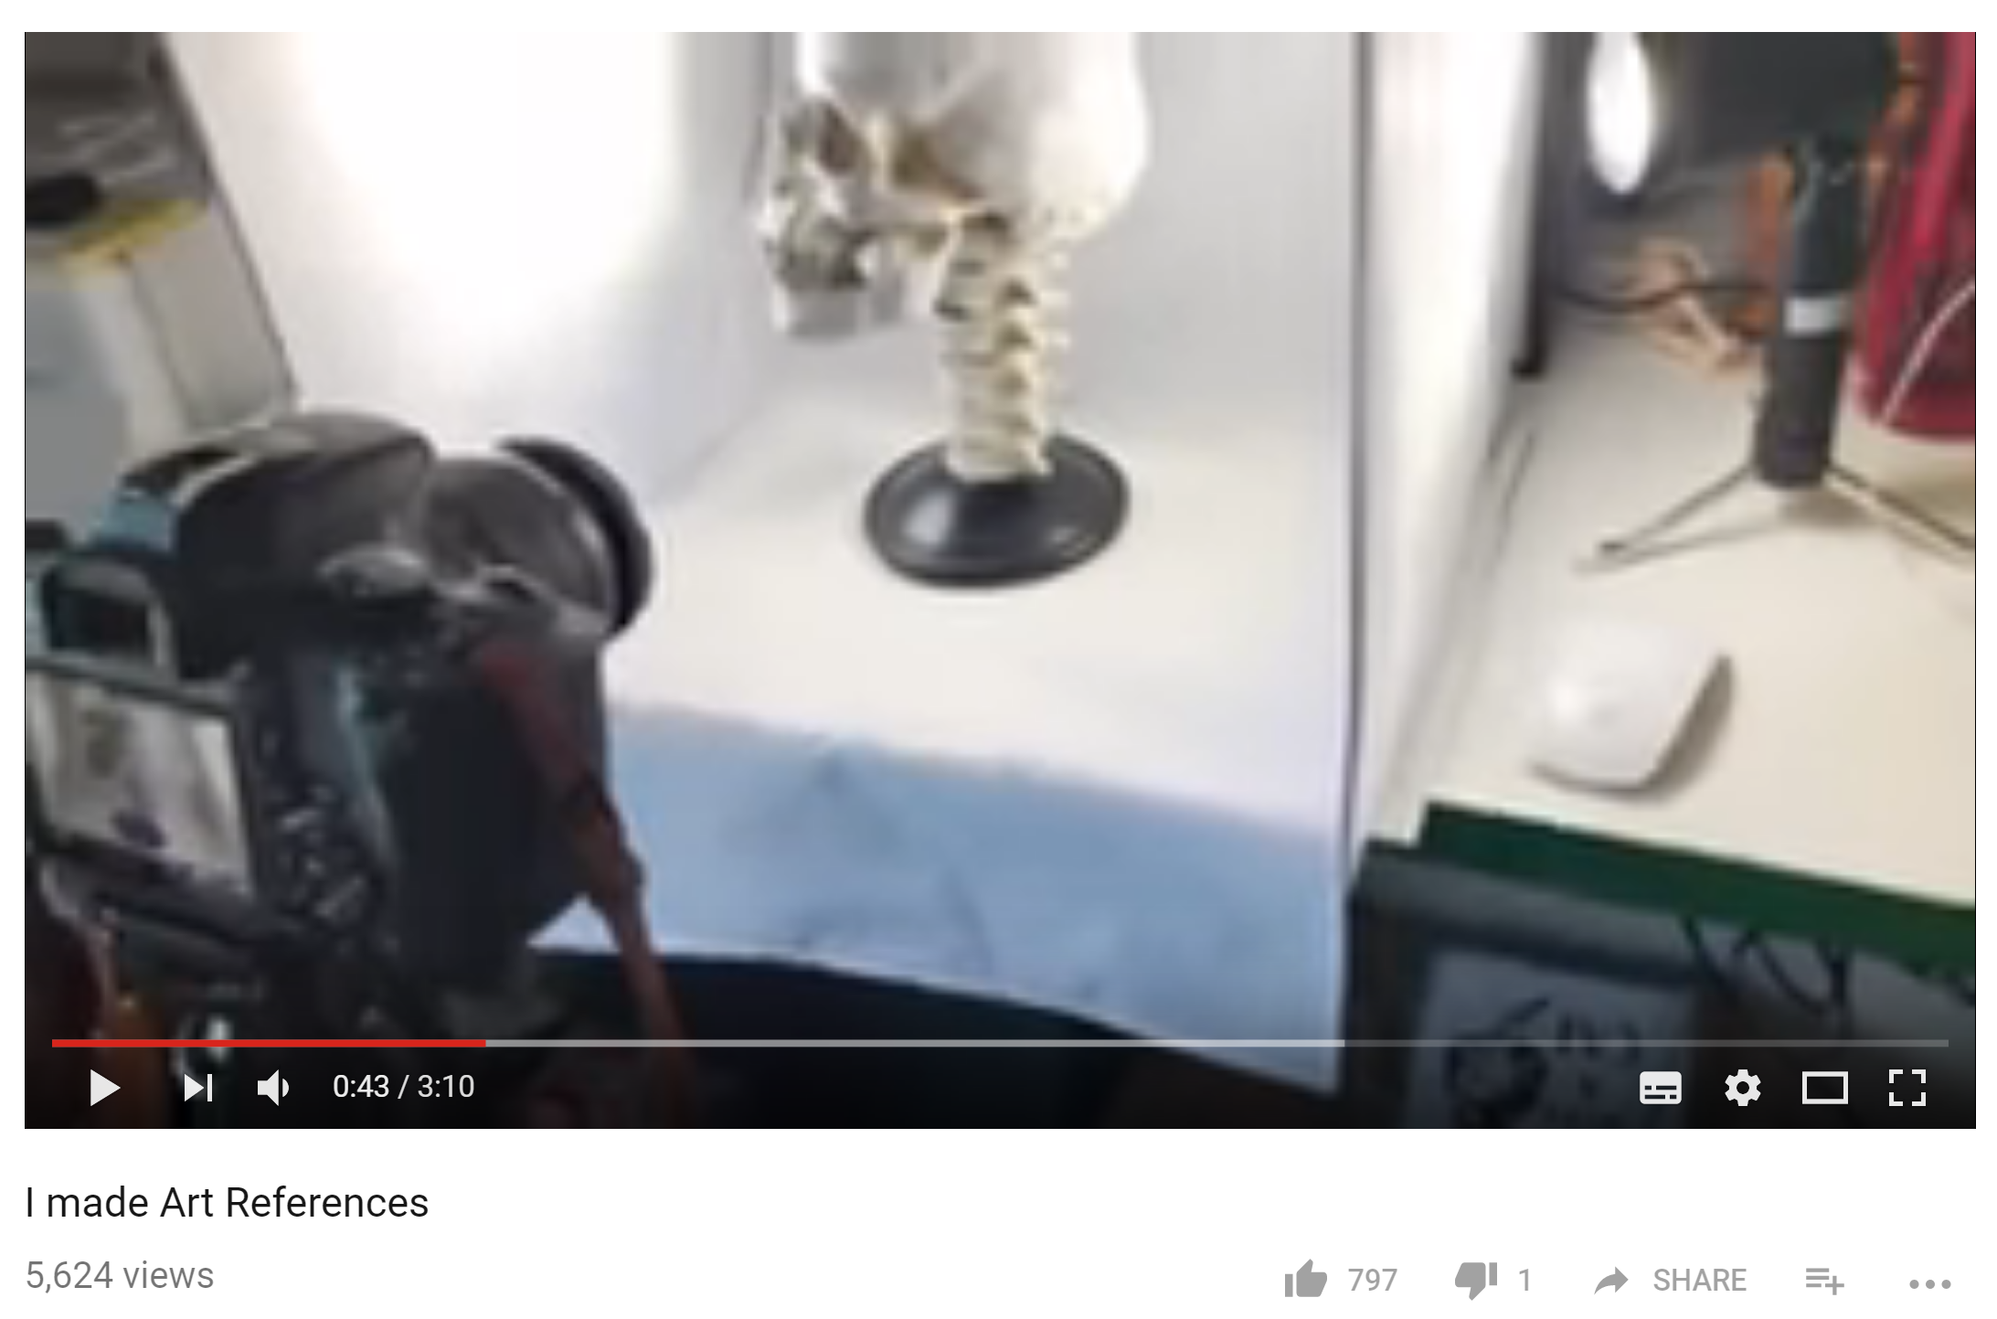
Making, Learning and Sharing
“Really I made these references for me but I thought I’d share with other people.”
https://www.youtube.com/watch?v=gOtlpLvT3w0

Slide 63
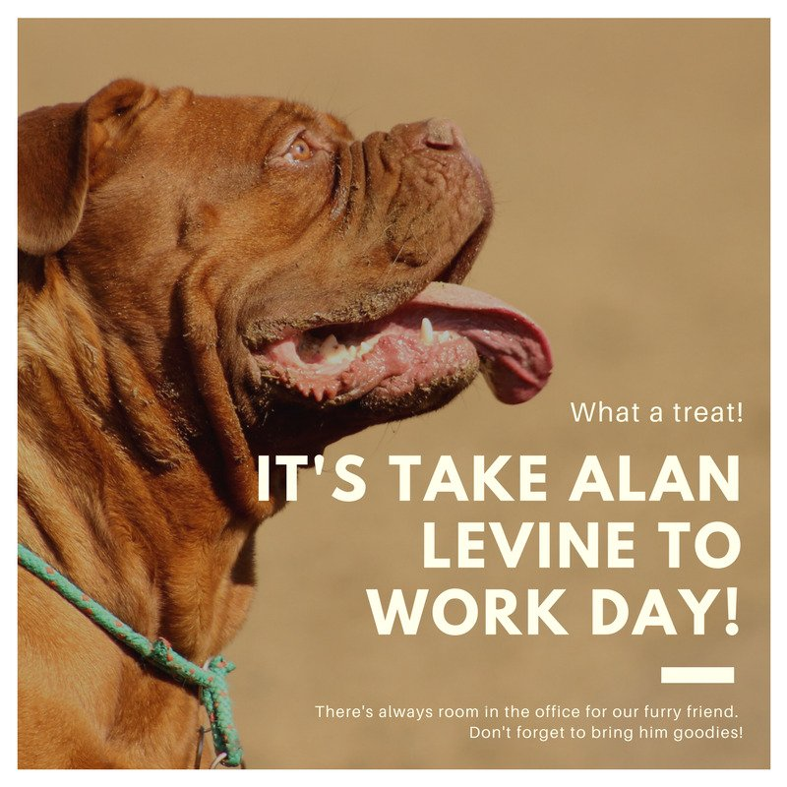

Making, Learning and Sharing
“Playing with Canva.”
https://www.canva.com/

Slide 64
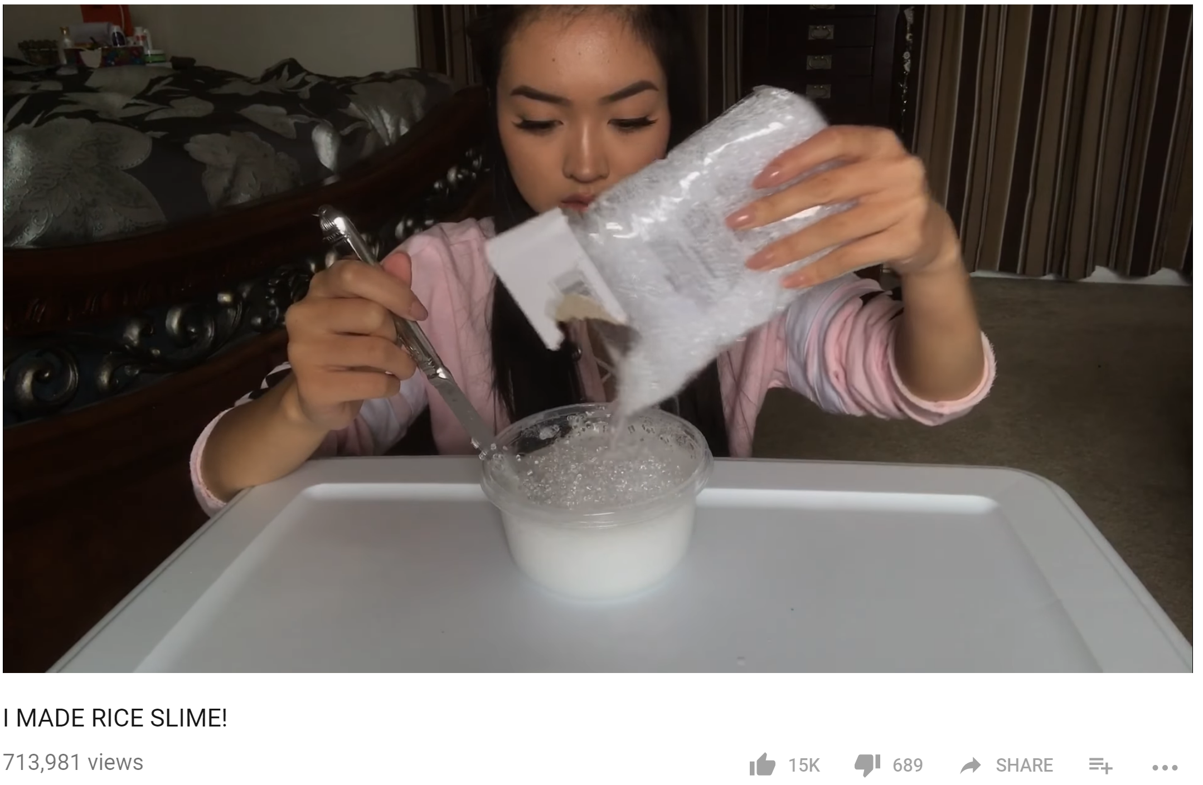
Making, Learning and Sharing
“A part of me kinda wishes I made it in a bigger bowl.”
https://www.youtube.com/watch?v=dcD3-kUUEDM

Slide 65
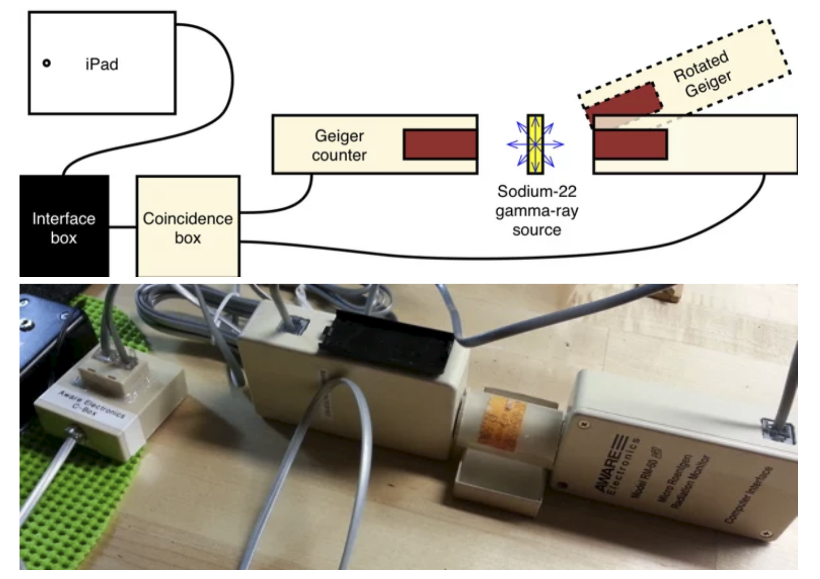
Making, Learning and Sharing
“How to Build Your Own Quantum Entanglement Experiment”
https://blogs.scientificamerican.com/critical-opalescence/how-to-build-your-own-quantum-entanglement-experiment-part-1-of-2/
https://blogs.scientificamerican.com/critical-opalescence/how-to-build-your-own-quantum-entanglement-experiment-part-2-of-2/

Slide 66
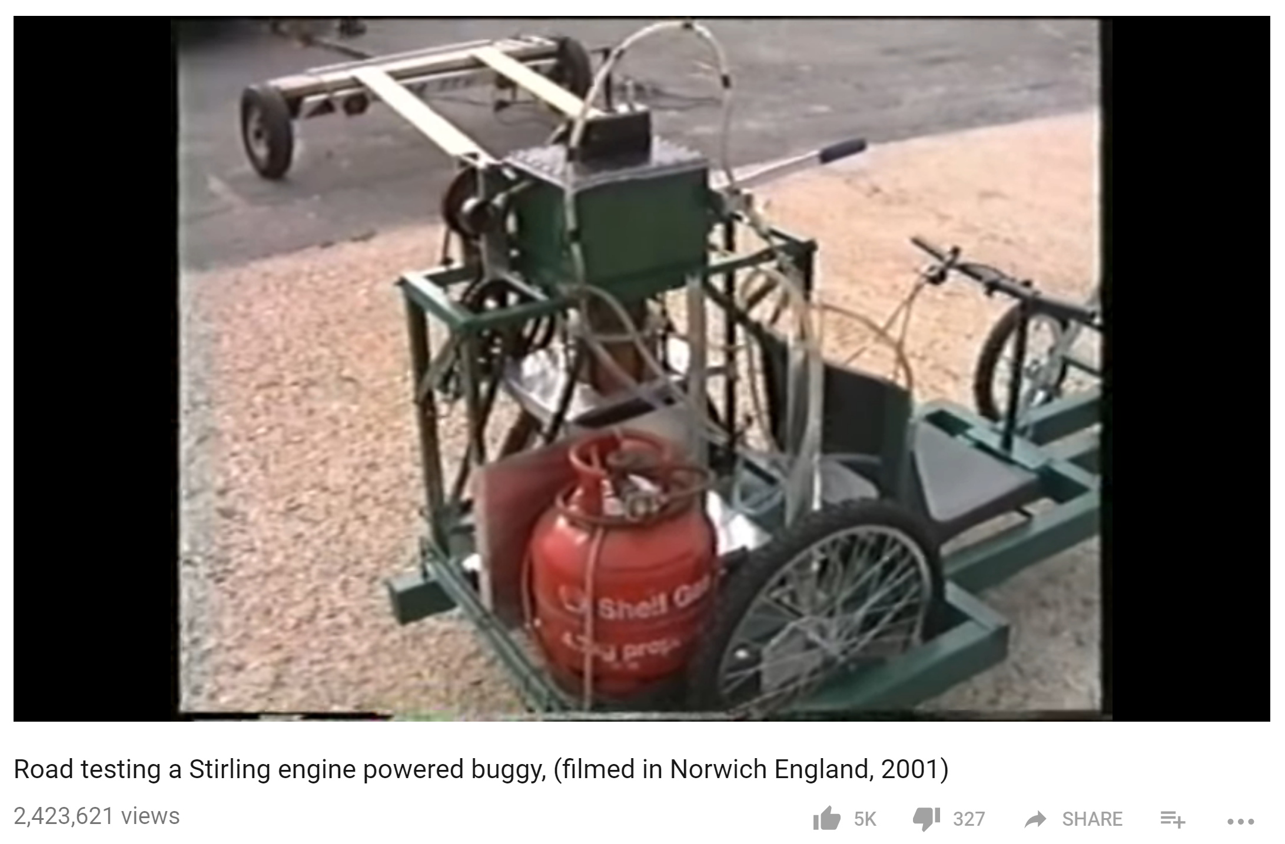
Making, Learning and Sharing
https://www.youtube.com/watch?v=qS5x91CZbtY

Slide 67
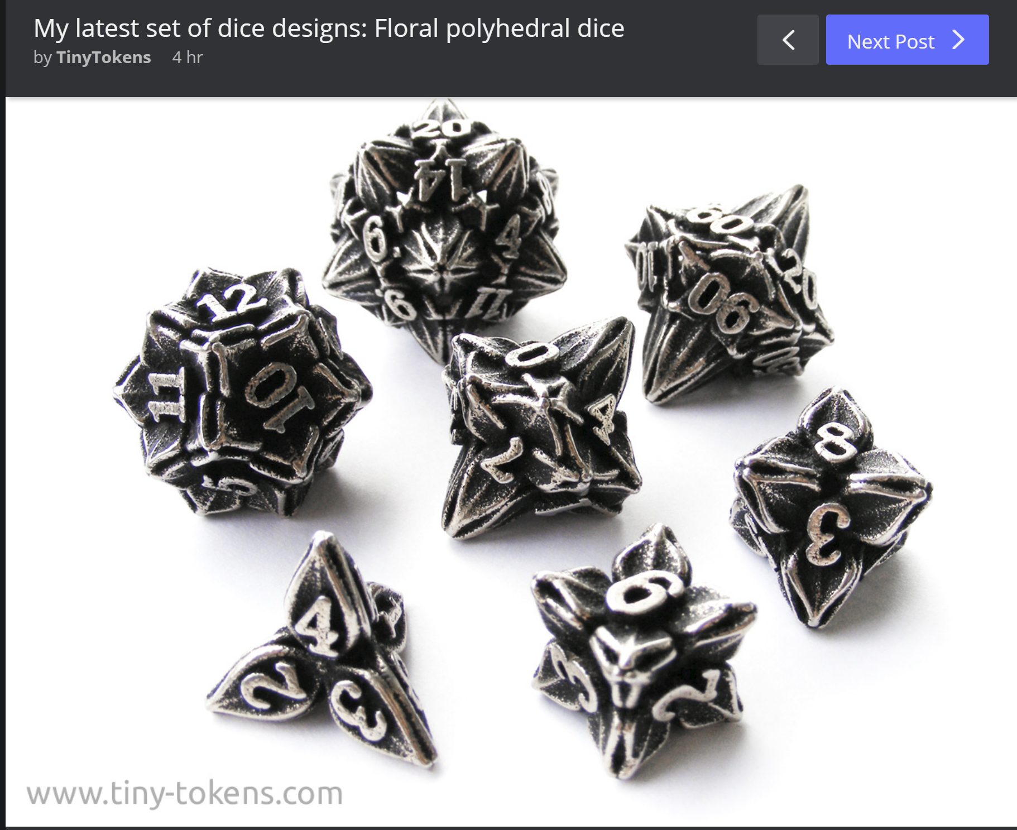
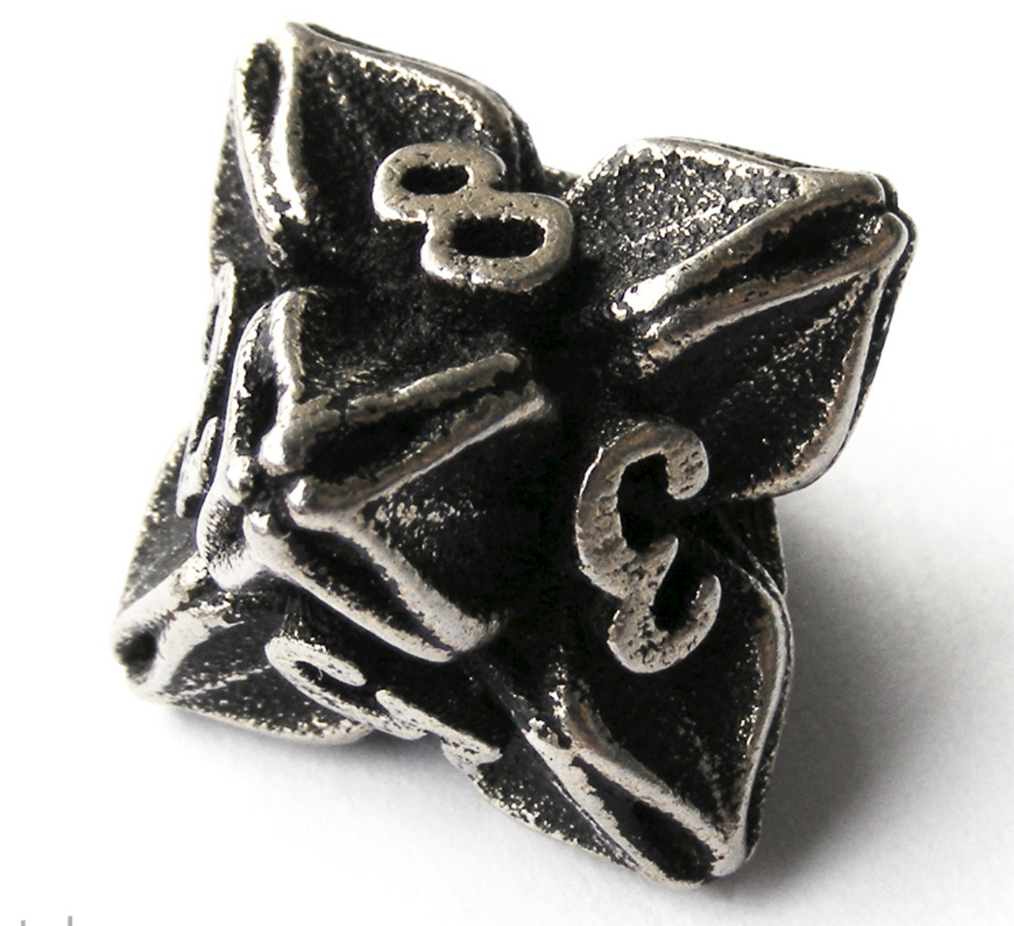
Making, Learning and Sharing
“All of the dice have been designed to be balanced and give a fair roll..”
https://imgur.com/gallery/WERPi

Slide 68
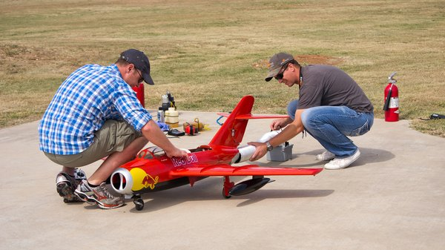
Making, Learning and Sharing
“It's always a good idea to have a fire extinguisher handy at the flying field, but it's mandatory with turbines. ”
http://www.tested.com/tech/589319-hobby-rc-introduction-rc-jets/

Slide 69
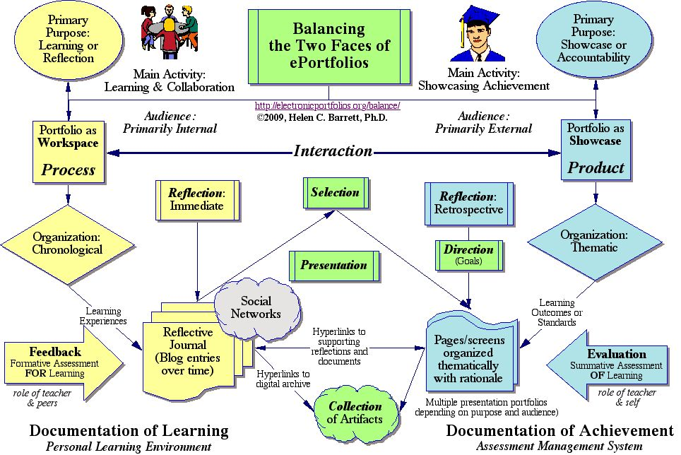
Our Portfolios
https://sites.google.com/site/eportfolioapps/overview

Slide 70

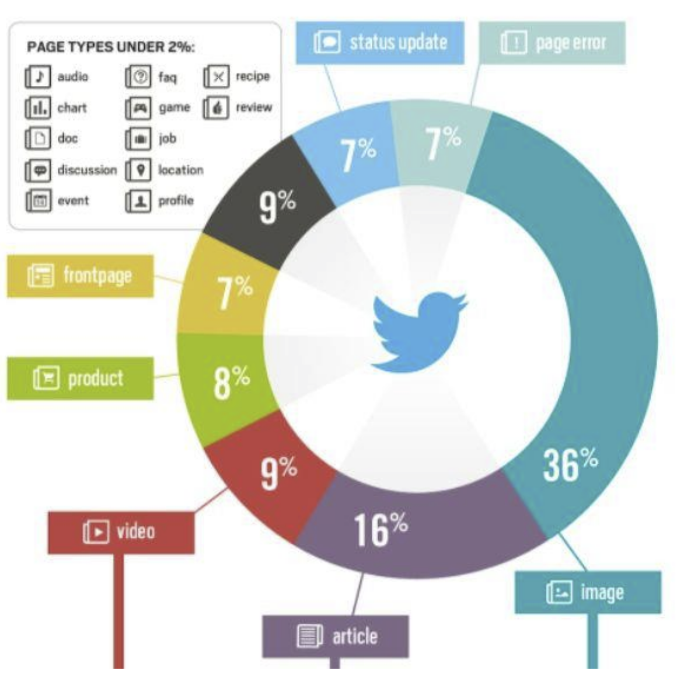
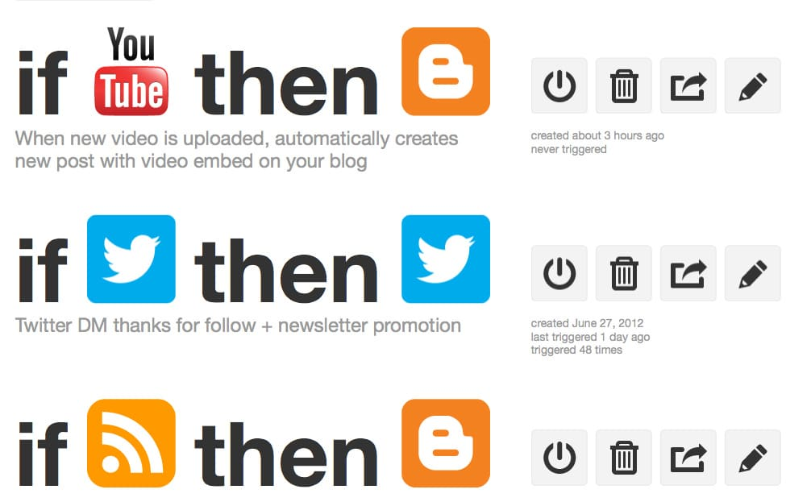
Feeding Forward
https://dcrazed.com/wordpress-social-network-plugins/
http://www.smallbizwebdesign.ca/what-to-share-on-social-media-sites/
https://ifttt.com/

Slide 71
Skills
Aggregate
Remix
Repurpose
Feed Forward

Slide 72
Literacies

Slide 73
Critical Literacies

Slide 74
Evidence

Slide 75
Evidence
Sources
Measures
Philosophical
  Quine, van Fraassen, Hanson
Mathematical
  Euler, Bayes
Biological
  Kosslyn, Churchland, Le Doux
Social
  Watts, Barabasi
Linguistic
  Lakoff
Completeness
  Godel, Newton
Simplicity
  Einstein
Fidelity
  Hume, Heidegger
Consistency
Prediction
  Hempel, Popper
Utility
  James, Pierce, Dewey

Slide 76
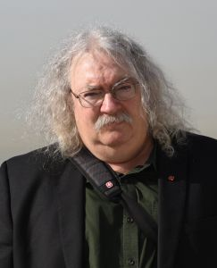
http://www.downes.ca

